Slide 1
Fixed-point design
SYSC5603 (ELG6163) Digital Signal Processing Microprocessors, Software and Applications
Miodrag Bolic

Slide 2
Overview
Introduction
Numeric representation
Simulation methods for floating to fixed point conversion
Analytical methods

Slide 3
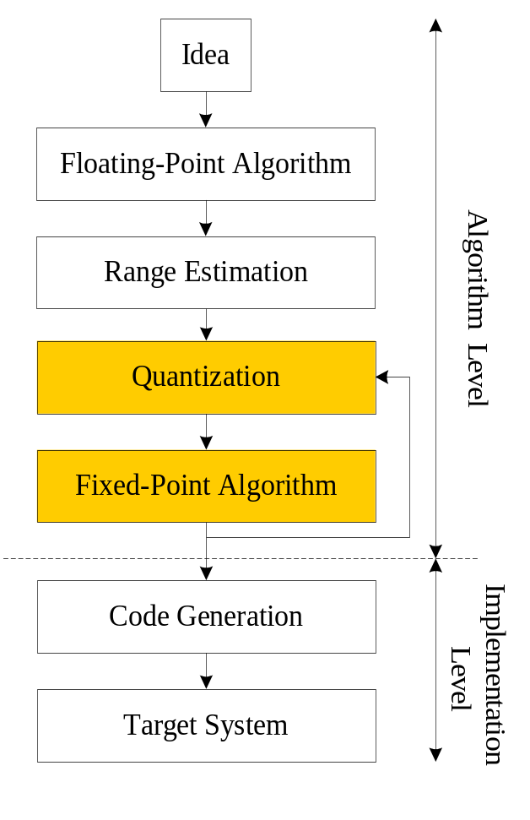
Fixed-Point Design
Digital signal processing algorithms
  Often developed in floating point
  Later mapped into fixed point for digital hardware realization
Fixed-point digital hardware
  Lower area
  Lower power
  Lower per unit production cost
Copyright Kyungtae Han [2]
Notes:
Design of most digital systems follows this process. When you have an idea, you simulate this idea in algorithm level and then with floating-point algorithm and quantize the wordlenths. In a complex system, 50% of the design time is typically spent on the
When the overflow occurs and increases integer bit some time decrease fractional bits. For the goal of this research is deducing the design time and find optimum wordlength automatically.

Slide 4
Fixed-Point Design
Float-to-fixed point conversion required to target
  ASIC and fixed-point digital signal processor core
  FPGA and fixed-point microprocessor core
All variables have to be annotated manually
  Avoid overflow
  Minimize quantization effects
  Find optimum wordlength
Manual process supported by simulation
  Time-consuming
  Error prone
Copyright Kyungtae Han [2]

Slide 5
Fixed-Point Representation
Fixed point type
  Wordlength
  Integer wordlength
Quantization modes
  Round
  Truncation
Overflow modes
  Saturation
  Saturation to zero
  Wrap-around
Wordlength
SystemC format
www.systemc.org
S
X
X
X
X
X
Wordlength
Integer wordlength
X
X
X
X
X
Integer wordlength = −2
Back
Copyright Kyungtae Han [2]

Slide 6
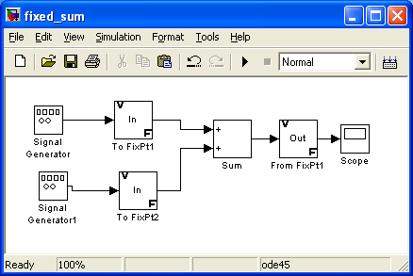
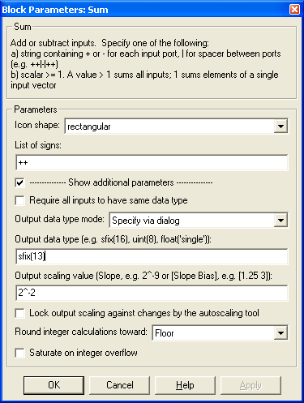
Tools for Fixed-Point Simulation
gFix (Seoul National University)
  Using C++, operator overloading
Simulink (Mathworks)
  Fixed-point block set 4.0
SPW (Cadence)
  Hardware design system
CoCentric (Synopsys)
  Fixed-point designer
float a;
float b;
float c;
c = a + b;
gFix a(12,1);
gFix b(12,1);
gFix c(13,2);
c = a + b;
Wordlengths determined manually
  Wordlength optimization tool needed
Copyright Kyungtae Han [2]

Slide 7
Optimum Wordlength
Longer wordlength
  May improve application
  performance
  Increases hardware cost
Shorter wordlength
  May increase quantization errors
  and overflows
  Reduces hardware cost
Optimum wordlength
  Maximize application performance
  or minimize quantization error
  Minimize hardware cost
Optimum
wordlength
Distortion d(w)
[1/performance]
Cost c(w)
Wordlength (w)
Copyright Kyungtae Han [2]
Notes:
Optimum wordlength can be select from the graph. Large wordlength reduces error. However, it increase costs.
On the other hand, short wordlength decreases costs but it increase error.

Slide 8
Wordlength Optimization Approach
Analytical approach
  Quantization error model
  For feedback systems, instability and limit cycles can occur
  Difficult to develop analytical quantization error model of adaptive or non-linear systems
Simulation-based approach
  Wordlengths chosen while observing error criteria
  Repeated until wordlengths converge
  Long simulation time
Copyright Kyungtae Han [2]

Slide 9
Overview
Introduction
Numeric representation
Simulation methods for floating to fixed point conversion
Analytical methods

Slide 10
Number representation
Matlab examples
Numeric circle
fi Basics
fi Binary Point Scaling

Slide 11
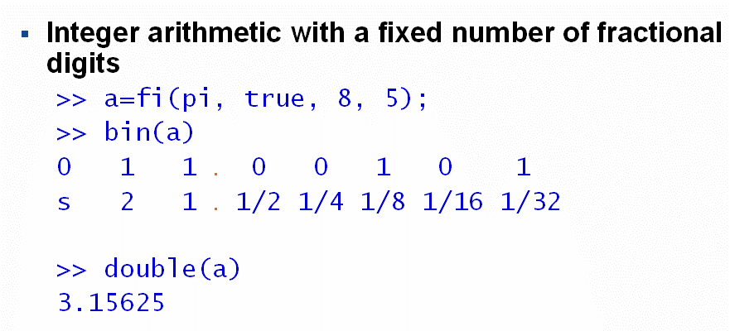
Fi type
www.mathworks.com

Slide 12
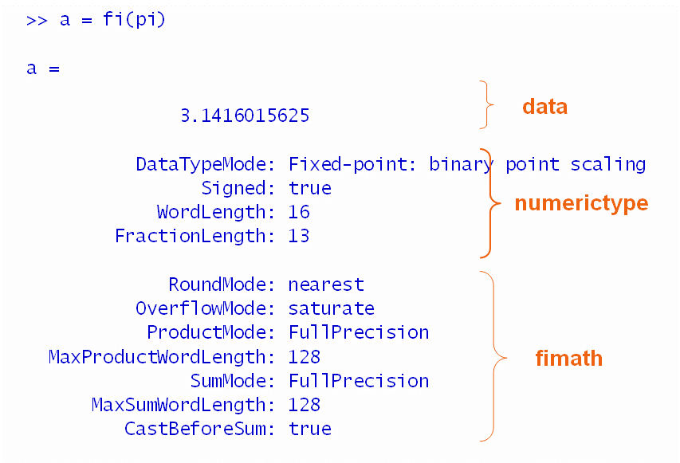
Fi object
www.mathworks.com

Slide 13
Fi Object
Notation
Multiplication
Multiplication with KeepMSB Mode
Addition
Addition with KeepLsb Mode
Numerictype
fimath
www.mathworks.com

Slide 14
Overview
Introduction
Numeric representation
Simulation methods for floating to fixed point conversion
Analytical methods

Slide 15
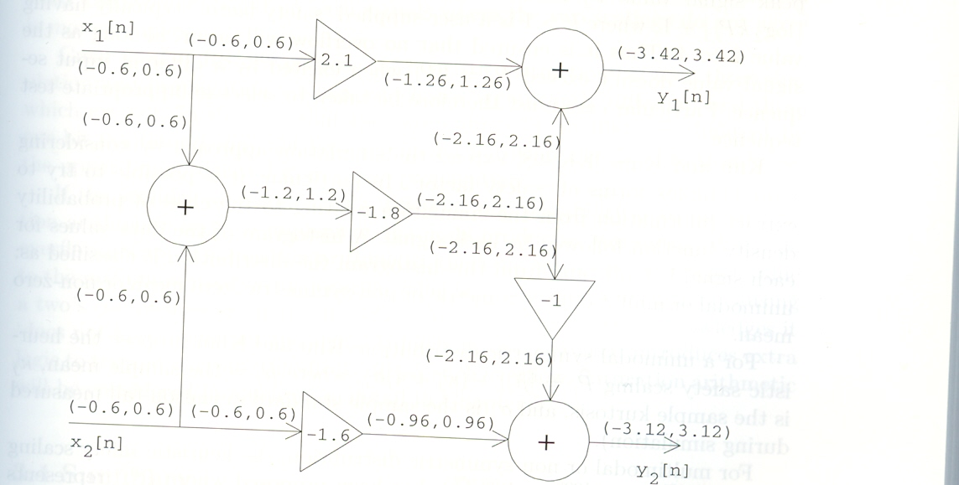
Data-range propagation
y1=2.1x1-1.8(x1+x2)=0.3x1-1.8x2
Input range: (-0.6 0.6)
Output range: (-1.26, 1.26)
[Constantinides04]

Slide 16
Data-range propagation
Disadvantages
Provide larger bounds on signal values than necessary
Solution
Simulation-based range estimation

Slide 17
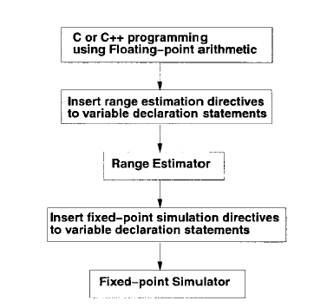
Development of fixed point programs
Toolbox gFix
[Sung95]

Slide 18
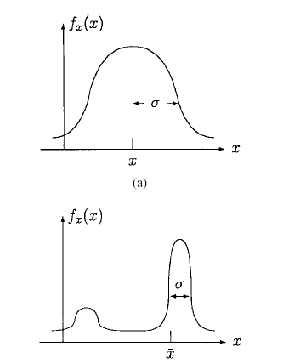


Statistical characteristics of input signals
[Sung95]

Slide 19
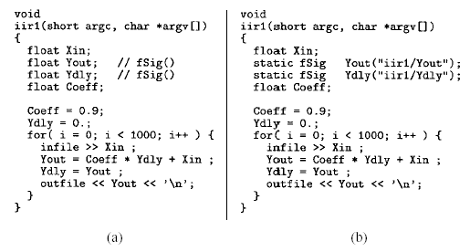
Implementation – range estimation
[Sung95]

Slide 20
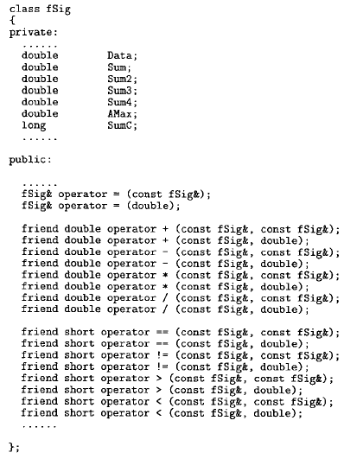
Implementation – range estimation
[Sung95]

Slide 21
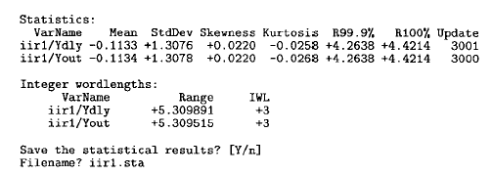
Result of the range estimator
[Sung95]

Slide 22
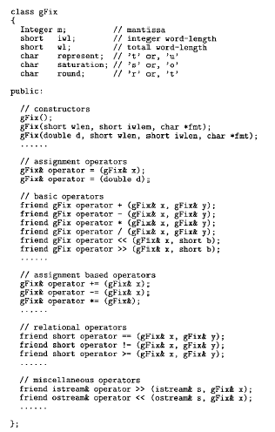
Fixed point simulation
[Sung95]

Slide 23
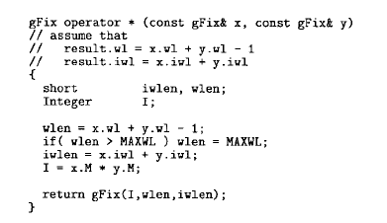
Operator overloading
[Sung95]

Slide 24
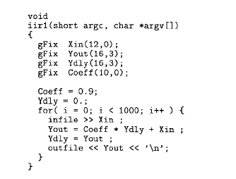
Fixed-precision algorithm
[Sung95]

Slide 25
Reducing the number of overflows in Matlab
1. Implement textbook algorithm in M.
2. Verify with builtin floating-point in M.
3. Convert to fixed-point in M and run with default settings.
4. Override the fi object with 'double' data type to log min and max values.
5. Use logged min and max values to set the fixed-point scaling.
6. Validate the fixed-point solution.
7. Convert M to C using Embedded MATLAB or Simulink to FPGA using Altera and Xilinx tools.
www.mathworks.com

Slide 26
Matlab functions
logreport
fi_best_numeric_type_from_logs

Slide 27
Overview
Introduction
Numeric representation
Simulation methods for floating to fixed point conversion
Analytical methods

Slide 28
Filter Implementation
Finite word-length effects (fixed point implementation)
- Coefficient quantization
- Overflow & quantization in arithmetic operations
    - scaling to prevent overflow
- quantization noise statistical modeling
- limit cycle oscillations
Copyright Marc Moonen [1]

Slide 29
Coefficient Quantization
The coefficient quantization problem :
Filter design in Matlab (e.g.) provides filter coefficients to 15 decimal digits (such that filter meets specifications)
For implementation, need to quantize coefficients to the word length used for the implementation.
As a result, implemented filter may fail to meet specifications… ??
PS: In present-day signal processors, this has become less of a problem (e.g. with 16 bits (=4 decimal digits) or 24 bits (=7 decimal digits) precision). In hardware design, with tight speed requirements, this is still a relevant problem.
Copyright Marc Moonen [1]

Slide 30
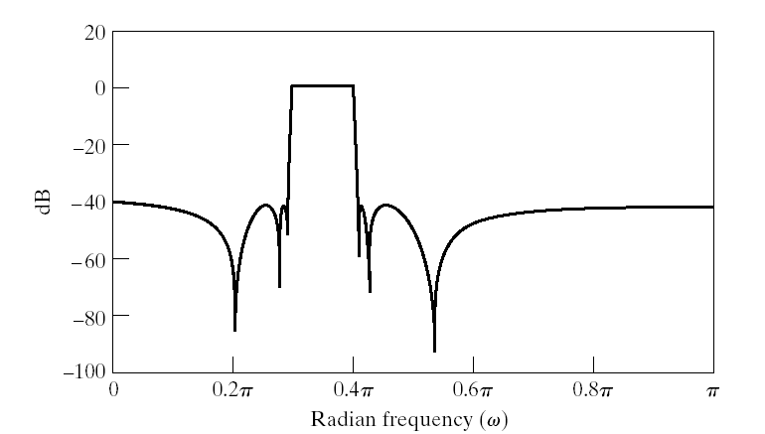
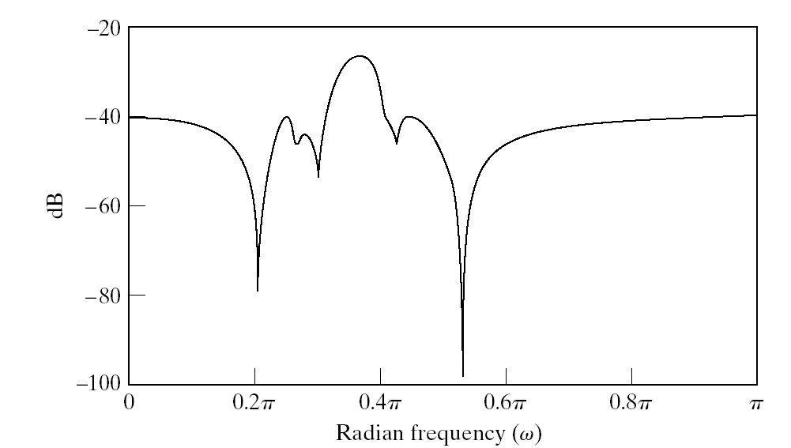
Coefficient Quantization
Coefficient quantization effect on pole locations :
-> tightly spaced poles (e.g. for narrow band filters) imply
high sensitivity of pole locations to coefficient quantization
-> hence preference for low-order systems (parallel/cascade)
Example: Implementation of a band-pass IIR 12-order filter
Cascade structure with 16-bit coeff.
Direct form with 16-bit coeff.

Slide 31
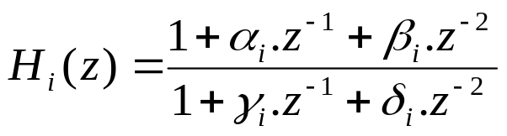
Coefficient Quantization
Coefficient quantization effect on pole locations :
example : 2nd-order system (e.g. for cascade realization)
Copyright Marc Moonen [1]

Slide 32
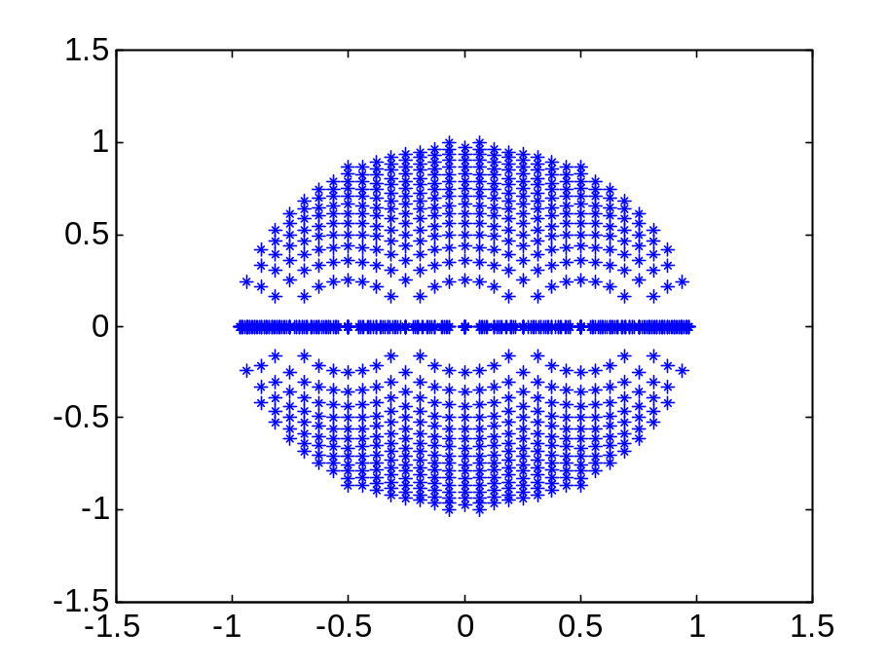
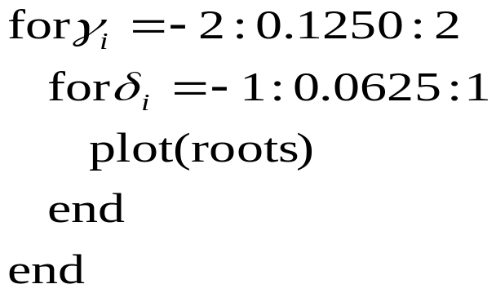
Coefficient Quantization
example (continued) :
with 5 bits per coefficient, all possible pole positions are...
Low density of permissible pole locations at z=1, z=-1, hence problem for narrow-band LP and HP filters
Copyright Marc Moonen [1]

Slide 33


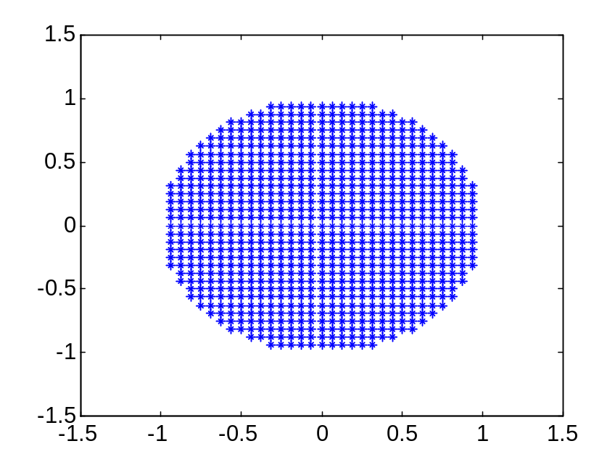





Coefficient Quantization
example (continued) :
possible remedy: `coupled realization’
poles are where are realized/quantized
hence permissible pole locations are (5 bits)
u[k]
+
-
+
+
y[k]
Copyright Marc Moonen [1]

Slide 34
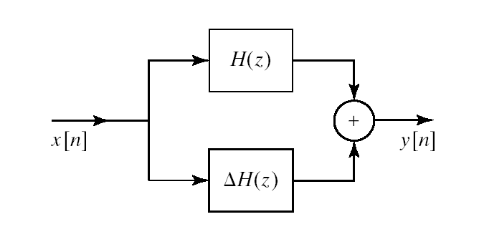
Quantization of an FIR filter
Transfer function ΔH(z)
The effect of coefficient quantization to linear phase
[Oppenheim98]

Slide 35
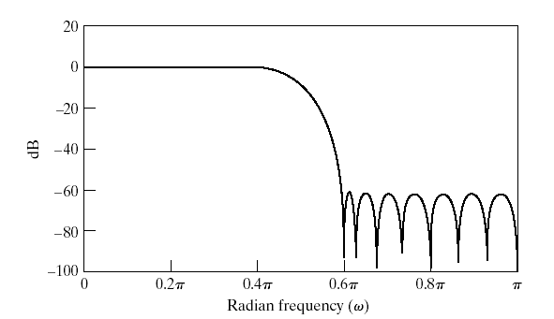
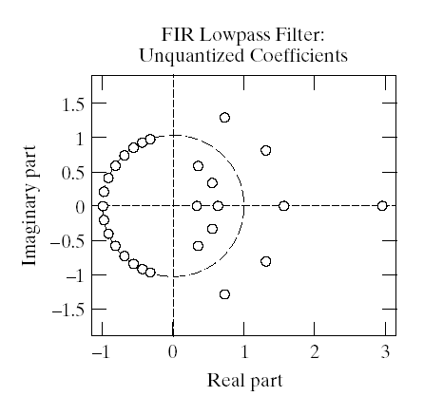
FIR filter example
Passband attenuation 0.01, Radial frequency (0,0.4π)
Stopband attenuation 0.001, Radial frequency (0.4π, π)
[Oppenheim98]

Slide 36
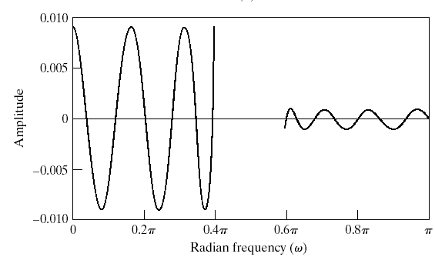
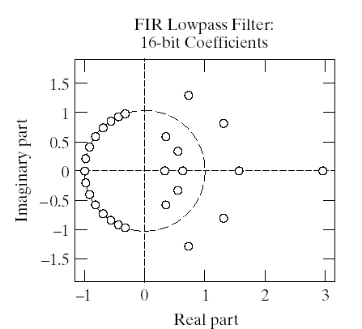
FIR filter example – 16bits
[Oppenheim98]

Slide 37
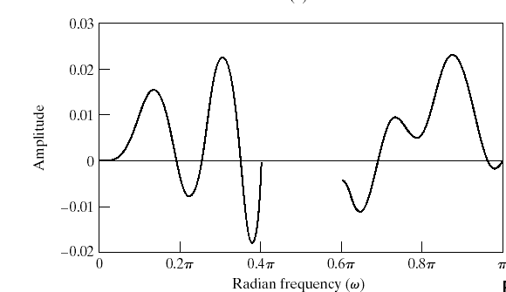
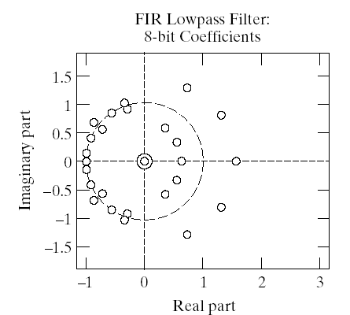
FIR filter example - 8bits
[Oppenheim98]

Slide 38
Arithmetic Operations
Finite word-length effects in arithmetic operations:
In linear filters, have to consider additions & multiplications
Addition:
if, two B-bit numbers are added, the result has (B+1) bits.
Multiplication:
if a B1-bit number is multiplied by a B2-bit number, the
result has (B1+B2-1) bits.
For instance, two B-bit numbers yield a (2B-1)-bit product
Typically (especially so in an IIR (feedback) filter), the result of an addition/multiplication has to be represented again as a B’-bit number (e.g. B’=B). Hence have to get rid of either most significant bits or least significant bits…
Copyright Marc Moonen [1]

Slide 39
Arithmetic Operations
Option-1: Most significant bits
If the result is known to be upper bounded so that the most significant bit(s) is(are) always redundant, it(they) can be dropped, without loss of accuracy.
This implies we have to monitor potential overflow, and introduce scaling strategy to avoid overflow.
Option-2 : Least significant bits
Rounding/truncation/… to B’ bits introduces quantization noise.
The effect of quantization noise is usually analyzed in a statistical manner.
Quantization, however, is a deterministic non-linear effect, which may give rise to limit cycle oscillations.
Copyright Marc Moonen [1]

Slide 40
Scaling
The scaling problem:
Finite word-length implementation implies maximum representable number. Whenever a signal (output or internal) exceeds this value, overflow occurs.
Digital overflow may lead (e.g. in 2’s-complement arithmetic) to polarity reversal (instead of saturation such as in analog circuits), hence may be very harmful.
Avoid overflow through proper signal scaling
Scaled transfer function may be c*H(z) instead of H(z) (hence need proper tracing of scaling factors)
Copyright Marc Moonen [1]

Slide 41

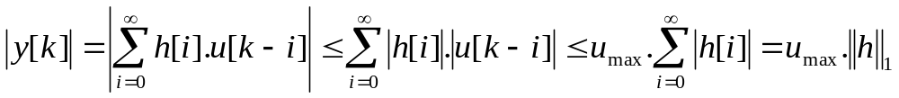

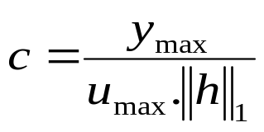
Scaling
Time domain scaling:
Assume input signal is bounded in magnitude
(i.e. u-max is the largest number that can be represented in the `words’ reserved for the input signal’)
Then output signal is bounded by
To satisfy
(i.e. y-max is the largest number that can be represented in the `words’
reserved for the output signal’)
we have to scale H(z) to c.H(z), with
Copyright Marc Moonen [1]

Slide 42
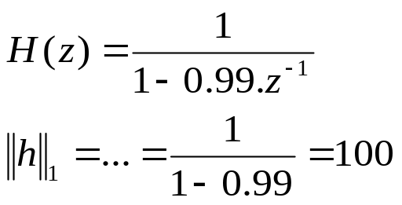
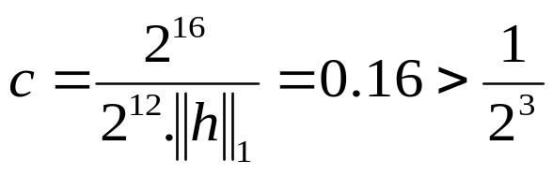
Scaling
Example:
assume u[k] comes from 12-bit A/D-converter
assume we use 16-bit arithmetic for y[k] & multiplier
hence inputs u[k] have to be shifted by
3 bits to the right before entering the filter
(=loss of accuracy!)
u[k]
+
0.99
x
y[k]
shift
+
u[k]
0.99
x
y[k]
Copyright Marc Moonen [1]

Slide 43
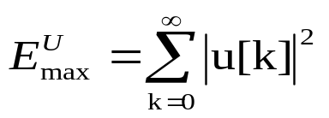
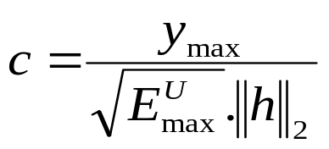
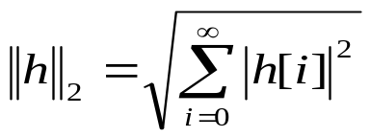
Scaling
L2-scaling: (`scaling in L2 sense’)
Time-domain scaling is simple & guarantees that overflow will never occur, but often over-conservative (=too small c)
If an `energy upper bound’ for the input signal is known
then L2-scaling uses
where
…is an L2-norm (this leads to larger c)
Copyright Marc Moonen [1]

Slide 44
Scaling
So far considered scaling of H(z), i.e. transfer function from u[k] to y[k]. In fact we also need to consider overflow and scaling of each internal signal, i.e. scaling of transfer function from u[k] to each and every internal signal !
This requires quite some thinking….
(but doable)
+
+
+
+
-a1
-a2
-a3
-a4
x
x
x
x
x1[k]
x2[k]
x3[k]
x4[k]
bo
b1
b2
b3
b4
x
x
x
x
x
y[k]
+
+
+
+
Copyright Marc Moonen [1]

Slide 45
Scaling
Something that may help: If 2’s-complement arithmetic is used, and if the sum of K numbers (K>2) is guaranteed not to overflow, then overflows in partial sums cancel out and do not affect the final result (similar to `modulo arithmetic’).
Example:
if x1+x2+x3+x4 is guaranteed not to
overflow, then if in (((x1+x2)+x3)+x4)
the sum (x1+x2) overflows, this overflow
can be ignored, without affecting the
final result.
As a result (1), in a direct form realization,
eventually only 2 signals have to be
considered in view of scaling :
+
+
+
+
-a1
-a2
-a3
-a4
x
x
x
x
x1[k]
x2[k]
x3[k]
x4[k]
bo
b1
b2
b3
b4
x
x
x
x
x
+
+
+
+
Copyright Marc Moonen [1]

Slide 46
Scaling
As a result (2), in a transposed direct form realization, eventually
only 1 signal has to be considered in view of scaling……….:
hence preference for transposed direct form over direct form.
u[k]
bo
b1
b2
b3
b4
x
x
x
x
x
x1[k]
x2[k]
x3[k]
x4[k]
+
+
+
+
-a1
-a2
-a3
-a4
x
x
x
x
y[k]
Copyright Marc Moonen [1]

Slide 47
Quantization Noise
The quantization noise problem :
If two B-bit numbers are added (or multiplied), the result is a B+1 (or 2B-1) bit number. Rounding/truncation/… to (again) B bits, to get rid of the least significant bit(s) introduces quantization noise.
The effect of quantization noise is usually analyzed in a statistical manner.
Quantization, however, is a deterministic non-linear effect, which may give rise to limit cycle oscillations.
PS: Will focus on multiplications only. Assume additions are implemented with sufficient number of output bits, or are properly scaled, or…
Copyright Marc Moonen [1]

Slide 48
Quantization Noise
Quantization mechanisms:
Rounding Truncation Magnitude Truncation
mean=0 mean=(-0.5)LSB (biased!) mean=0
variance=(1/12)LSB^2 variance=(1/12)LSB^2 variance=(1/6)LSB^2
output
input
probability
error
Copyright Marc Moonen [1]

Slide 49
Quantization Noise
Statistical analysis based on the following assumptions :
- each quantization error is random, with uniform probability distribution function (see previous slide)
- quantization errors at the output of a given multiplier are uncorrelated/independent (=white noise assumption)
- quantization errors at the outputs of different multipliers are uncorrelated/independent (=independent sources assumption)
One noise source is inserted for each multiplier.
Since the filter is linear filter the output noise generated by each noise source is added to the output signal.
Copyright Marc Moonen [1]

Slide 50


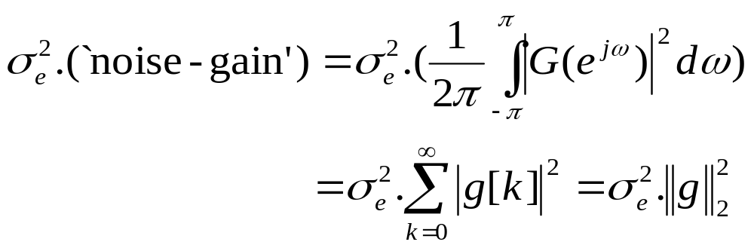
Quantization Noise
The effect on the output signal of noise generated at a particular point in the filter is computed as follows:
noise is e[k]. noise mean & variance are
transfer function from from e[k] to filter output is G(z),g[k] (‘noise transfer function’)
Noise mean at the output is
Noise variance at the output is (remember L2-norm!)
Repeat procedure for each noise source…
u[k]
+
+
e[k]
-.99
x
y[k]
Copyright Marc Moonen [1]

Slide 51
Quantization Noise
In a transposed direct realization all `noise transfer functions’ are equal (up to delay), hence all noise sources can be lumped into one equivalent source
etc...
u[k]
bo
b1
b2
b3
b4
x
x
x
x
x
x1[k]
x2[k]
x3[k]
x4[k]
e[k]
+
+
+
+
-a1
-a2
-a3
-a4
x
x
x
x
y[k]
Copyright Marc Moonen [1]

Slide 52
Quantization Noise
In a direct realization all noise sources can be lumped into two equivalent sources
etc...
e1[k]
u[k]
+
+
+
+
-a1
-a2
-a3
-a4
x
x
x
x
x1[k]
x2[k]
x3[k]
x4[k]
bo
b1
b2
b3
b4
x
x
x
x
x
y[k]
+
+
+
+
e2[k]
Copyright Marc Moonen [1]

Slide 53
Quantization Noise
PS: Quantization noise of A/D-converters can be modeled/analyzed in a similar fashion.
Noise transfer function is filter transfer function H(z).
Copyright Marc Moonen [1]

Slide 54
Limit Cycles
Statistical analysis is simple/convenient, but quantization is truly a non-linear effect, and should be analyzed as a deterministic process.
Though very difficult, such analysis may reveal odd behavior:
Example: y[k] = -0.625.y[k-1]+u[k]
4-bit rounding arithmetic
input u[k]=0, y[0]=3/8
output y[k] = 3/8, -1/4, 1/8, -1/8, 1/8, -1/8, 1/8, -1/8, 1/8,..
Oscillations in the absence of input (u[k]=0) are called
`zero-input limit cycle oscillations’.
Copyright Marc Moonen [1]

Slide 55
Limit Cycles
Example: y[k] = -0.625.y[k-1]+u[k]
4-bit truncation (instead of rounding)
input u[k]=0, y[0]=3/8
output y[k] = 3/8, -1/4, 1/8, 0, 0, 0,.. (no limit cycle!)
Example: y[k] = 0.625.y[k-1]+u[k]
4-bit rounding
input u[k]=0, y[0]=3/8
output y[k] = 3/8, 1/4, 1/8, 1/8, 1/8, 1/8,..
Example: y[k] = 0.625.y[k-1]+u[k]
4-bit truncation
input u[k]=0, y[0]=-3/8
output y[k] = -3/8, -1/4, -1/8, -1/8, -1/8, -1/8,..
Conclusion: weird, weird, weird,… !
Copyright Marc Moonen [1]

Slide 56
Limit Cycles
Limit cycle oscillations are clearly unwanted (e.g. may be audible in speech/audio applications)
Limit cycle oscillations can only appear if the filter has feedback. Hence FIR filters cannot have limit cycle oscillations.
Mathematical analysis is very difficult.
Truncation often helps to avoid limit cycles (e.g. magnitude truncation, where absolute value of quantizer output is never larger than absolute value of quantizer input (`passive quantizer’)).
Some filter structures can be made limit cycle free, e.g. coupled realization, orthogonal filters (see below).
Copyright Marc Moonen [1]

Slide 57
References
Marc Moonen, Lecture 4 : Filter implementation, lecture slides.
Kyungtae Han, ``Fixed-Point Wordlength Optimization and Its Applications to Broadband Wireless Demodulator Design,'' Samsung Advanced Institute of Technology, Korea, Jun 24, 2004

